Slide 1
SOIL

Slide 2
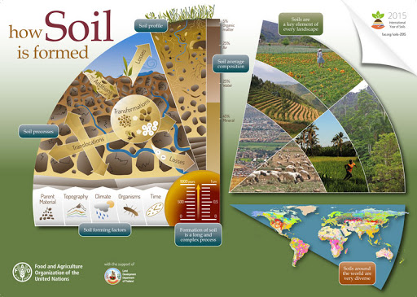
Soils are complex mixtures of minerals, water, air, organic matter, and countless organisms that are the decaying remains of once-living things. It forms at the surface of land – it is the “skin of the earth. How is soil formed?

Slide 3
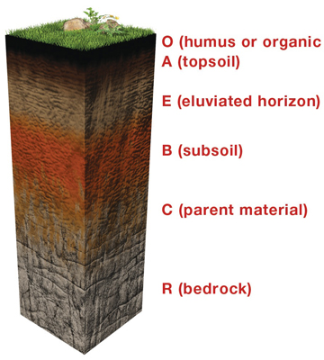
LAYERS OF SOIL

Slide 4
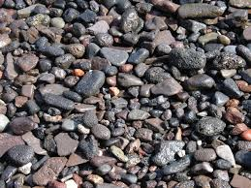
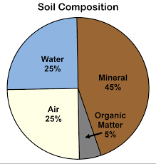
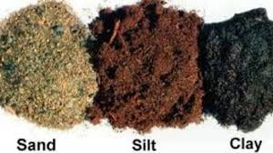
Gravel, sand, silt and clay
Soil composition:

Slide 5
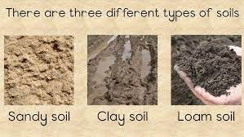
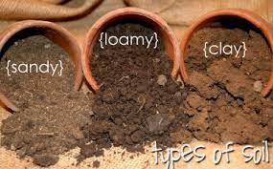
Types of soil.

Slide 6
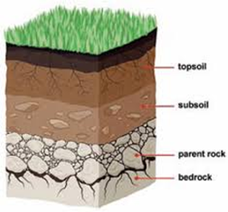
Soil profile:

Slide 7
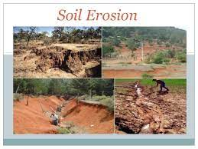
Soil erosion: “Soil erosion is the natural process in which the topsoil of a field is carried away by physical sources such as wind and water.”

Slide 8
Soil Conservation: Soil conservation is a "combination" of practices used to protect the soil from degradation.
Types of soil conservation: Afforestation.
Checking Overgrazing.
Changing Agricultural Practices.
Crop Rotation.
Terrace farming, etc

Slide 9
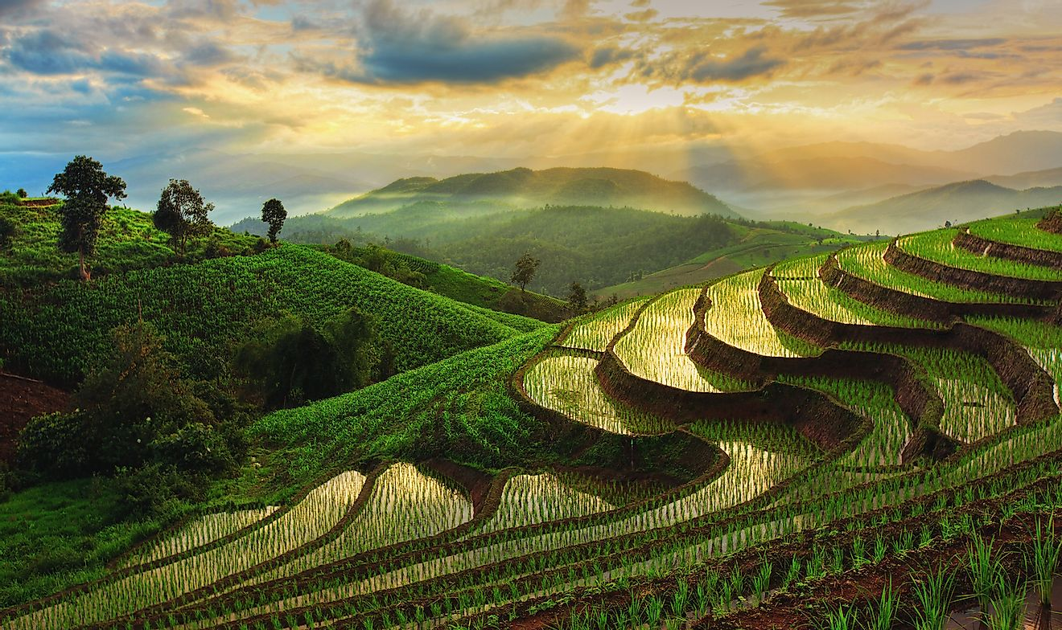
Terrace farming:

Slide 10
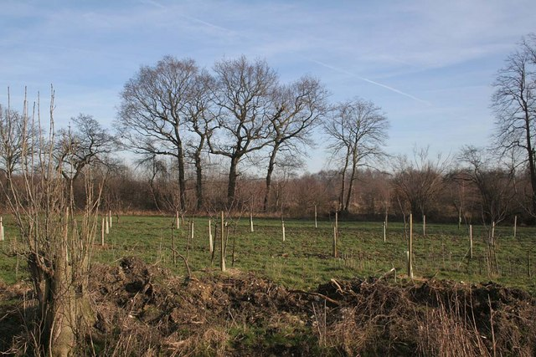
Afforestation:

Slide 11
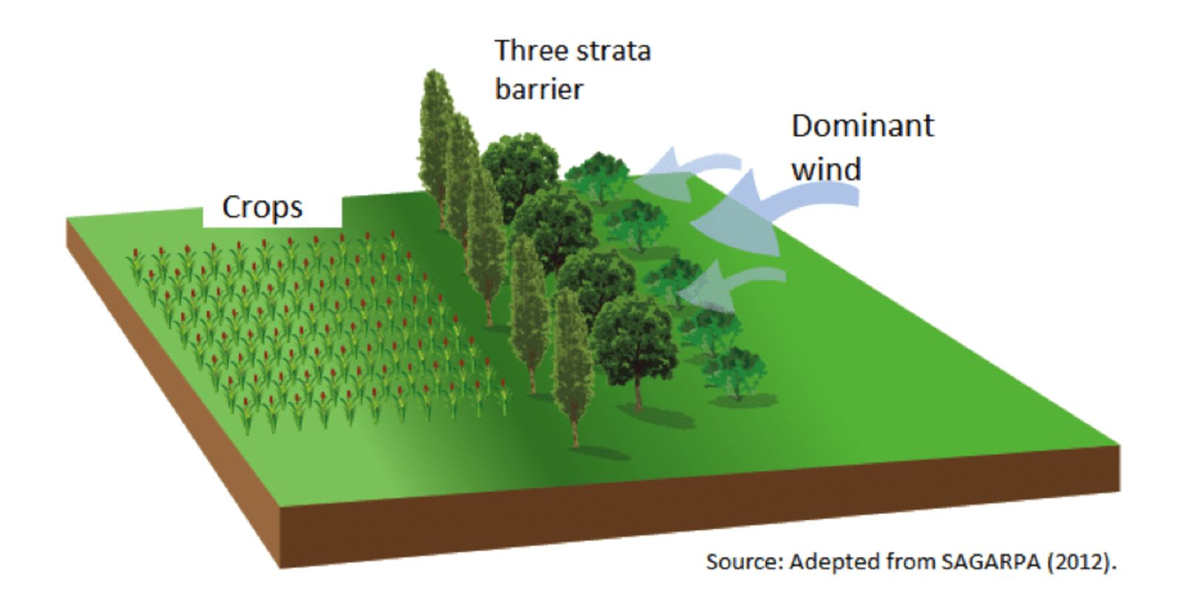
Wind breaks:

